Slide 1
Light absorption

Slide 2
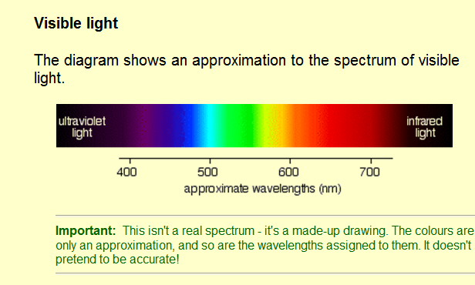
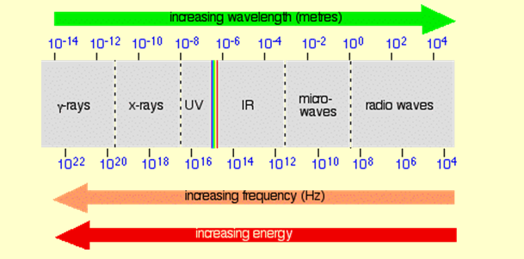
Electro Magnetic spectrum
Notes:
Electro magnetic spectrum
The main colour regions of the spectrum are approximately:
colour region wavelength (nm) violet 380 - 435 blue 435 - 500 cyan 500 - 520 green 520 - 565 yellow 565 - 590 orange 590 - 625 red 625 - 740 Don't assume that there is some clear cut-off point between all these colours. In reality, the colours just merge seamlessly into one another - much more seamlessly than in my diagram!

Slide 4
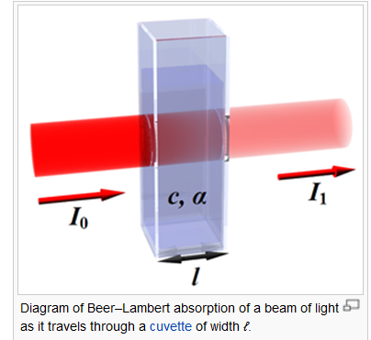

Slide 5
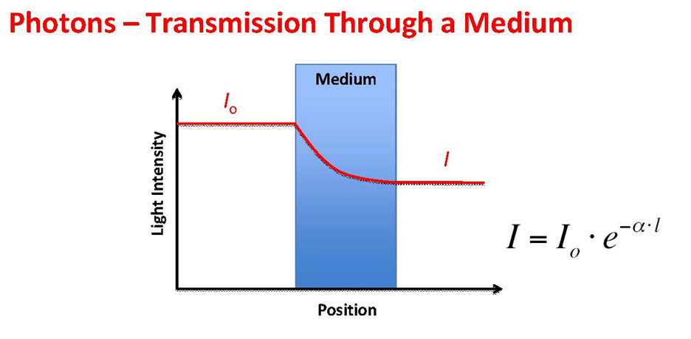
Beer lamber’s law
Notes:
The law states that there is a logarithmic dependence between the transmission (or transmissivity), T, of light through a substance and the product of the absorption coefficient of the substance, α, and the distance the light travels through the material (i.e. the path length), ℓ.

Slide 6
For liquids, these relations are usually written as:
whereas for gases, and in particular among physicists and for spectroscopy and spectrophotometry, they are normally written
Notes:
The absorption coefficient can, in turn, be written as a product of either a molar absorptivity (extinction coefficient) of the absorber, ε, and the concentration c of absorbing species in the material, or an absorption cross section, σ, and the (number) density N' of absorbers.
σ is cross section of light absorption by a single particle and N is the density (number per unit volume) of absorbing particles.
The base 10 and base e conventions must not be confused because they give different values for the absorption coefficient: . However, it is easy to convert one to the other, using .
Absorption cross section is a measure for the probability of an absorption process. More generally, the term cross section is used in physics to quantify the probability of a certain particle-particle interaction, e.g., scattering, photoabsorption, etc. (Note that light in this context is described as consisting of particles, i.e., photons.)
In the context of ozone shielding of ultraviolet light, absorption cross section is the ability of a molecule to absorb a photon of a particular wavelength and polarization. Analogously, in the context of nuclear engineering it refers to the probability of a particle (usually a neutron) being absorbed by a nucleus. Although the units are given as an area, it does not refer to an actual size area, at least partially because the density or state of the target molecule will affect the probability of absorption.

Slide 8
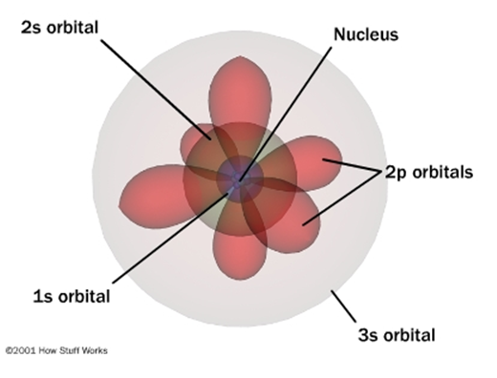
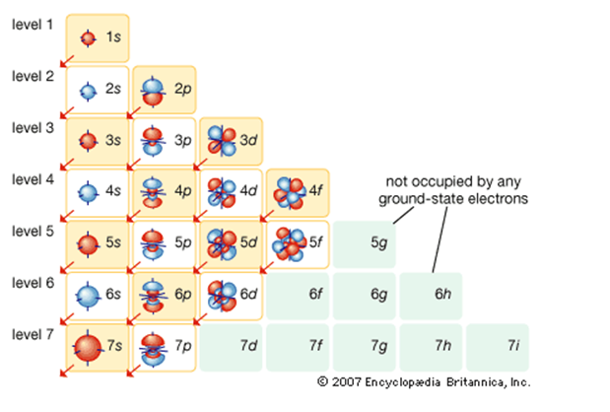

Slide 9
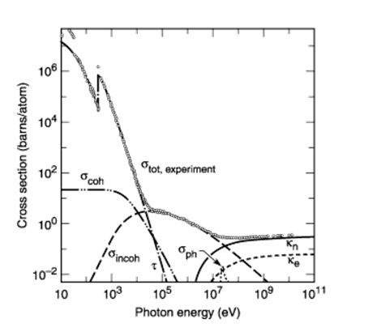
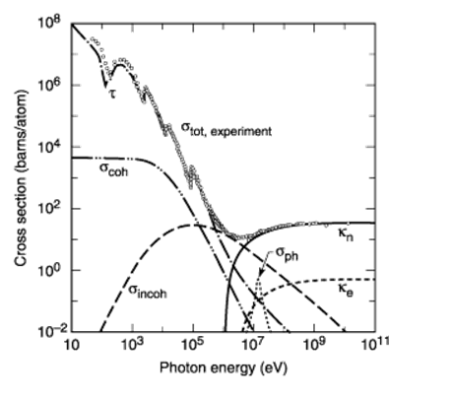

Slide 18
Notes:
The spectrum of the Sun's solar radiation is close to that of a black body with a temperature of about 5,800 K.^{[7]} The Sun emits EM radiation across most of the electromagnetic spectrum. Although the Sun produces Gamma rays as a result of the Nuclear fusion process, these super high energy photons are converted to lower energy photons before they reach the Sun's surface and are emitted out into space, so the Sun doesn't give off any gamma rays to speak of. The Sun does, however, emit X-rays, ultraviolet, visible light , infrared, and even Radio waves.^{[8]} When ultraviolet radiation is not absorbed by the atmosphere or other protective coating, it can cause damage to the skin known as sunburn or trigger an adaptive change in human skin pigmentation.
The spectrum of electromagnetic radiation striking the Earth's atmosphere spans a range of 100 nm to about 1 mm. This can be divided into five regions in increasing order of wavelengths:^{[9]}
Ultraviolet C or (UVC) range, which spans a range of 100 to 280 nm. The term ultraviolet refers to the fact that the radiation is at higher frequency than violet light (and, hence also invisible to the human eye). Owing to absorption by the atmosphere very little reaches the Earth's surface (Lithosphere). This spectrum of radiation has germicidal properties, and is used in germicidal lamps.
Ultraviolet B or (UVB) range spans 280 to 315 nm. It is also greatly absorbed by the atmosphere, and along with UVC is responsible for the photochemical reaction leading to the production of the ozone layer.
Ultraviolet A or (UVA) spans 315 to 400 nm. It has been traditionally held as less damaging to the DNA, and hence used in tanning and PUVA therapy for psoriasis.
Visible range or light spans 380 to 780 nm. As the name suggests, it is this range that is visible to the naked eye.
Infrared range that spans 700 nm to 10⁶ nm (1 mm). It is responsible for an important part of the electromagnetic radiation that reaches the Earth. It is also divided into three types on the basis of wavelength:
Infrared-A: 700 nm to 1,400 nm
Infrared-B: 1,400 nm to 3,000 nm
Infrared-C: 3,000 nm to 1 mm.

Slide 19
Light absorption and Charge Tranport in Organic Marials

Slide 20
Notes:
Pi bonds are usually weaker than sigma bonds. From the perspective of quantum mechanics, this bond's weakness is explained by significantly less overlap between the component p-orbitals due to their parallel orientation.

Slide 21
Promotion of electrons
Notes:
This page explains what happens when organic compounds absorb UV or visible light, and why the wavelength of light absorbed varies from compound to compound.
When we were talking about the various sorts of orbitals present in organic compounds on the introductory page (see above), you will have come across this diagram showing their relative energies:
Remember that the diagram isn't intended to be to scale - it just shows the relative placing of the different orbitals.
When light passes through the compound, energy from the light is used to promote an electron from a bonding or non-bonding orbital into one of the empty anti-bonding orbitals.
For a-bond 6-12ev
For pi-bond 1-3ev

Slide 22
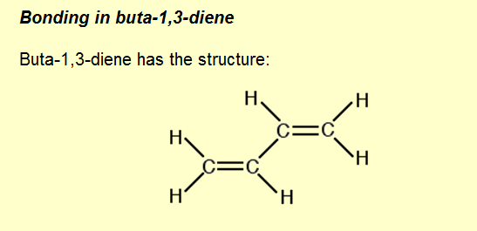
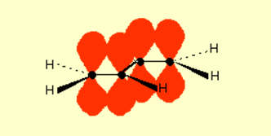
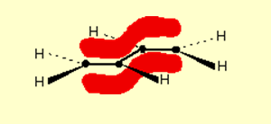
conjugation
Notes:
The interaction of the two double bonds with each other to produce a delocalised system of pi electrons over all four atoms is known as conjugation. Conjugation in this context literally means "joining together".
Now picture the formation of the various molecular orbitals as if you were thinking about two ethene molecules joined together. You would have sigma bonds formed by the end-to-end overlap of various orbitals on the carbons and hydrogens. That would leave you with a p-orbital on each carbon atom.
Those p-orbitals will overlap sideways - all of them! A system of delocalised pi bonds is formed, similar to the benzene case that you are probably familiar with. The diagram shows one of those molecular orbitals.

Slide 25
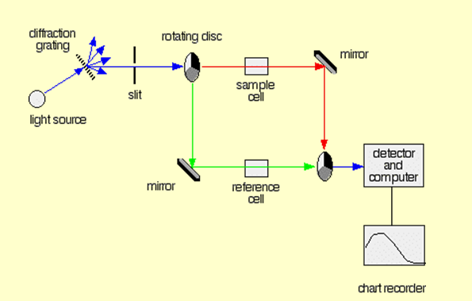
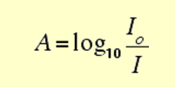
absorption spectrometer
Notes:
If you pass white light through a coloured substance, some of the light gets absorbed. A solution containing hydrated copper(II) ions, for example, looks pale blue because the solution absorbs light from the red end of the spectrum. The remaining wavelengths in the light combine in the eye and brain to give the appearance of cyan (pale blue).
Some colourless substances also absorb light - but in the ultra-violet region. Since we can't see UV light, we don't notice this absorption.
Different substances absorb different wavelengths of light, and this can be used to help to identify the substance - the presence of particular metal ions, for example, or of particular functional groups in organic compounds.
The amount of absorption is also dependent on the concentration of the substance if it is in solution. Measurement of the amount of absorption can be used to find concentrations of very dilute solutions.
An absorption spectrometer measures the way that the light absorbed by a compound varies across the UV and visible spectrum.
You need a light source which gives the entire visible spectrum plus the near ultra-violet so that you are covering the range from about 200 nm to about 800 nm. (This extends slightly into the near infra-red as well.)
Note: "Near UV" and "near IR" simply means the parts of the UV and IR spectra which are close to the visible spectrum. If you aren't happy about how the various types of electromagnetic radiation relate to each other, follow this link before you go on. Use the BACK button on your browser to return here later.
You can't get this range of wavelengths from a single lamp, and so a combination of two is used - a deuterium lamp for the UV part of the spectrum, and a tungsten / halogen lamp for the visible part.
Note: A deuterium lamp contains deuterium gas under low pressure subjected to a high voltage. It produces a continuous spectrum in the part of the UV spectrum we are interested in.
The combined output of these two bulbs is focussed on to a diffraction grating.
The diffraction grating and the slit
You are probably familiar with the way that a prism splits light into its component colours. A diffraction grating does the same job, but more efficiently.
The blue arrows show the way the various wavelengths of the light are sent off in different directions. The slit only allows light of a very narrow range of wavelengths through into the rest of the spectrometer.
By gradually rotating the diffraction grating, you can allow light from the whole spectrum (a tiny part of the range at a time) through into the rest of the instrument.
The rotating discs
This is the clever bit! Each disc is made up of a number of different segments. Those in the machine we are describing have three different sections - other designs may have a different number.
The light coming from the diffraction grating and slit will hit the rotating disc and one of three things can happen.
If it hits the transparent section, it will go straight through and pass through the cell containing the sample. It is then bounced by a mirror onto a second rotating disc.
This disc is rotating such that when the light arrives from the first disc, it meets the mirrored section of the second disc. That bounces it onto the detector.
It is following the red path in the diagram:
If the original beam of light from the slit hits the mirrored section of the first rotating disc, it is bounced down along the green path. After the mirror, it passes through a reference cell (more about that later).
Finally the light gets to the second disc which is rotating in such a way that it meets the transparent section. It goes straight through to the detector.
If the light meets the first disc at the black section, it is blocked - and for a very short while no light passes through the spectrometer. This just allows the computer to make allowance for any current generated by the detector in the absence of any light.
The sample and reference cells
These are small rectangular glass or quartz containers. They are often designed so that the light beam travels a distance of 1 cm through the contents.
The sample cell contains a solution of the substance you are testing - usually very dilute. The solvent is chosen so that it doesn't absorb any significant amount of light in the wavelength range we are interested in (200 - 800 nm).
The reference cell just contains the pure solvent.
The detector and computer
The detector converts the incoming light into a current. The higher the current, the greater the intensity of the light.
For each wavelength of light passing through the spectrometer, the intensity of the light passing through the reference cell is measured. This is usually referred to as I_{o} - that's I for Intensity.
The intensity of the light passing through the sample cell is also measured for that wavelength - given the symbol, I.
If I is less than I_{o}, then obviously the sample has absorbed some of the light. A simple bit of maths is then done in the computer to convert this into something called the absorbance of the sample - given the symbol, A.
For reasons which will become clearer when we do a bit of theory on another page, the relationship between A and the two intensities is given by:
On most of the diagrams you will come across, the absorbance ranges from 0 to 1, but it can go higher than that.
An absorbance of 0 at some wavelength means that no light of that particular wavelength has been absorbed. The intensities of the sample and reference beam are both the same, so the ratio I_{o}/I is 1. Log₁₀ of 1 is zero.
An absorbance of 1 happens when 90% of the light at that wavelength has been absorbed - which means that the intensity is 10% of what it would otherwise be.
In that case, I_{o}/I is 100/I0 (=10) and log₁₀ of 10 is 1.
The chart recorder
Chart recorders usually plot absorbance against wavelength.

Slide 26
Notes:
Quantum confinement(function of particle size, shape) changes light absorption characteristics dtrastically, for the same material.

Slide 28
Notes:
In physics, chemistry and materials science, percolation (from Lat. percōlāre, to filter or trickle through) concerns the movement and filtering of fluids through porous materials.

Slide 29
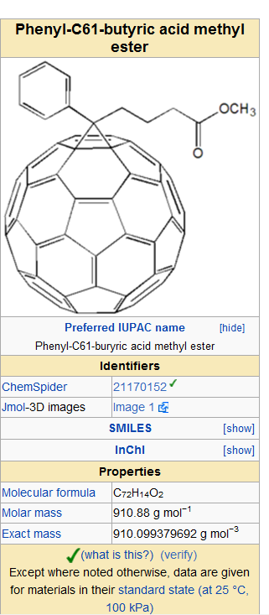
http://en.wikipedia.org/wiki/Luminous_intensity
Notes:
Photoluminescence (abbreviated as PL) is a process in which a substance absorbs photons (electromagnetic radiation) and then re-radiates photons. Quantum mechanically, this can be described as an excitation to a higher energy state and then a return to a lower energy state accompanied by the emission of a photon. This is one of many forms of luminescence (light emission) and is distinguished by photoexcitation (excitation by photons), hence the prefix photo-.^{[1]} The period between absorption and emission is typically extremely short, in the order of 10 nanoseconds. Under special circumstances, however, this period can be extended into minutes or hours.
Ultimately, available energy states and allowed transitions between states (and therefore wavelengths of light preferentially absorbed and emitted) are determined by the rules of quantum mechanics. A basic understanding of the principles involved can be gained by studying the electron configurations and molecular orbitals of simple atoms and molecules. More complicated molecules and advanced subtleties are treated in the field of computational chemistry.
The simplest photoluminescent processes are resonant radiations, in which a photon of a particular wavelength is absorbed and an equivalent photon is immediately emitted. This process involves no significant internal energy transitions of the chemical substrate between absorption and emission and is extremely fast, of the order of 10 nanoseconds.
More interesting processes occur when the chemical substrate undergoes internal energy transitions before re-emitting the energy from the absorption event. The most familiar such effect is fluorescence, which is also typically a fast process, but in which some of the original energy is dissipated so that the emitted light photons are of lower energy than those absorbed. The generated photon in this case is said to be red shifted, referring to the loss of energy as Jablonski diagram shows.
Photoluminescence is an important technique for measuring the purity and crystalline quality of semiconductors such as GaAs and InP. Several variations of photoluminescence exist, including photoluminescence excitation (PLE).
Time-resolved photoluminescence (TRPL) is a method where the sample is excited with a light pulse and then the decay in photoluminescence with respect to time is measured. This technique is useful in measuring the minority carrier lifetime of III-V semiconductors like Gallium arsenide (GaAs.)
An even more specialized form of photoluminescence is phosphorescence, in which the energy from absorbed photons undergoes intersystem crossing into a state of higher spin multiplicity (see term symbol), usually a triplet state. Once the energy is trapped in the triplet state, transition back to the lower singlet energy states is quantum mechanically forbidden, meaning that it happens much more slowly than other transitions. The result is a slow process of radiative transition back to the singlet state, sometimes lasting minutes or hours. This is the basis for "glow in the dark" substances.
PCBM is the common abbreviation for the fullerene derivative [6,6]-phenyl-C₆₁-butyric acid methyl ester. It is being investigated in organic solar cells^{[1]}.
PCBM is a fullerene derivative of the C₆₀ buckyball that was first synthesized in the 1990s.^{[2]} It is an electron acceptor material and is often used in plastic solar cells or flexible electronics in conjunction with electron donor materials such as P3HT or other polymers. It is a more practical choice for an electron acceptor when compared with fullerenes because of its solubility in chlorobenzene. This allows for solution processable donor/acceptor mixes, a necessary property for "printable" solar cells. However, considering the cost of fabricating fullerenes, it is not certain that this derivative can be synthesized on a large scale for commercial applications.
In photometry, luminous intensity is a measure of the wavelength-weighted power emitted by a light source in a particular direction per unit solid angle, based on the luminosity function, a standardized model of the sensitivity of the human eye. The SI unit of luminous intensity is the candela (cd), an SI base unit.
Photometry deals with the measurement of visible light as perceived by human eyes. The human eye can only see light in the visible spectrum and has different sensitivities to light of different wavelengths within the spectrum. When adapted for bright conditions (photopic vision), the eye is most sensitive to greenish-yellow light at 555 nm. Light with the same radiant intensity at other wavelengths has a lower luminous intensity. The curve which measures the response of the human eye to light is a defined standard, known as the luminosity function. This curve, denoted V(λ) or , is based on an average of widely differing experimental data from scientists using different measurement techniques. For instance, the measured responses of the eye to violet light varied by a factor of ten.
Luminous intensity should not be confused with another photometric unit, luminous flux, which is the total perceived power emitted in all directions. Luminous intensity is the perceived power per unit solid angle. Luminous intensity is also not the same as the radiant intensity, the corresponding objective physical quantity used in the measurement science of radiometry.
Contents
[hide]
1 Units
2 Usage
3 See also
4 References
[edit] Units
Like other SI base units, the candela has an operational definition—it is defined by the description of a physical process that will produce one candela of luminous intensity. By definition, if one constructs a light source that emits monochromatic green light with a frequency of 540 THz, and that has a radiant intensity of 1/683 watts per steradian in a given direction, that light source will emit one candela in the specified direction.^{[1]}
The frequency of light used in the definition corresponds to a wavelength of 555 nm, which is near the peak of the eye's response to light. If the source emitted uniformly in all directions, the total radiant flux would be about 18.40 mW, since there are 4π steradians in a sphere. A typical candle produces very roughly one candela of luminous intensity.
Prior to the definition of the candela, variety of units for luminous intensity were used in various countries. These were typically based on the brightness of the flame from a "standard candle" of defined composition, or the brightness of an incandescent filament of specific design. One of the best-known of these standards was the English standard: candlepower. One candlepower was the light produced by a pure spermaceti candle weighing one sixth of a pound and burning at a rate of 120 grains per hour. Germany, Austria, and Scandinavia used the hefnerkerze, a unit based on the output of a Hefner lamp.^{[2]} In 1881, Jules Violle proposed the Violle as a unit of luminous intensity, and it was notable as the first unit of light intensity that did not depend on the properties of a particular lamp. All of these units were superseded by the definition of the candela.
[edit] Usage
The luminous intensity for monochromatic light of a particular wavelength λ is given by
where
I_{V} is the luminous intensity in candelas (cd), I is the radiant intensity in watts per steradian (W/sr), is the standard luminosity function. If more than one wavelength is present (as is usually the case), one must sum or integrate over the spectrum of wavelengths present to get the luminous intensity:

